Slide 1


Anisul Arman Course_ID: IS 362 Data Acquisition and Management
Final Project

Slide 2
Proposal and Motivation
I decided to work on two different topics to explore and analyze data from two distinct sources: API and Web scrapping
Topic 1: Analysis of Price Trends for Mercedes-Benz Cars in the USA
Motivation: To understand the key factors influencing the pricing of Mercedes-Benz vehicles in the US market and to assist both buyers and sellers in making well-informed decisions.
Data Source: Kaggle - USA Mercedes-Benz Prices Dataset (accessed via Kaggle API)
Topic 2: Exploring the Relationship Between Fertility Rate and Median Age Across Countries
Motivation: To investigate how fertility rates correlate with median age worldwide, providing valuable insights into global population dynamics and demographic trends.
Data Source: Data scraped from HTML tables on www.worldometers.info

Slide 3
Data Analytics Workflow
1. Data Acquisition
2. Data Transformation & Cleaning
3. Exploratory Data Analysis (EDA)
4. Statistical Analysis & Modeling
5. Visualization & Presentation
6. Conclusion & Insights

Slide 4
Analysis of Price Trends for Mercedes-Benz Cars in the USA
Hypotheses
Null Hypothesis (H₀): There is no significant relationship between the car’s model year, mileage, and its price. In other words, newer cars with lower mileage are not necessarily more expensive.
Alternative Hypothesis (H₁): Newer cars with lower mileage are significantly more expensive.
Data Transformation and Analysis
Removed units like 'mi' and '$' from data and converted fields to numeric format for analysis.
Extracted key features such as car year and model name from the title column.
Grouped the dataset by year and model to compute average prices and analyze trends.
Conducted correlation analysis to identify relationships between mileage, ratings, reviews, and price.
Built interactive visualizations using Plotly to display trends and patterns clearly.
Used the Kaggle API to access and download the dataset programmatically.
Developed a Linear Regression model to predict car prices based on key features.

Slide 5
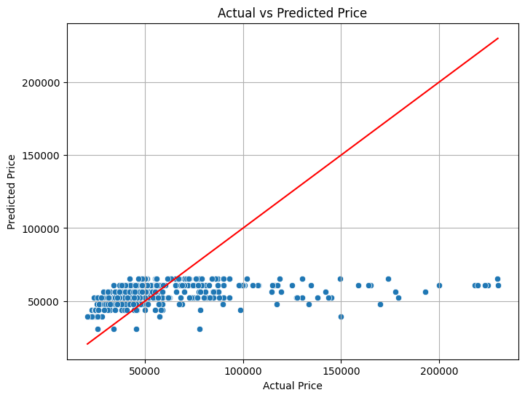
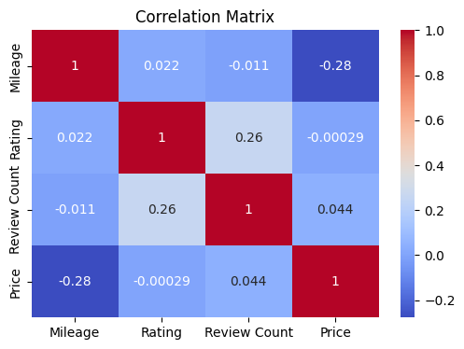
Insights and Visuals For
The model generally underpredicts car prices, especially for high-value vehicles, as seen from most points falling below the diagonal in the actual vs predicted price plot.
Predictions are heavily clustered around $50,000, indicating potential bias or limitations in the model's ability to capture variation in high-end prices.
The correlation matrix shows that mileage has the strongest negative correlation with price (-0.28), meaning cars with higher mileage tend to be cheaper.

Slide 6
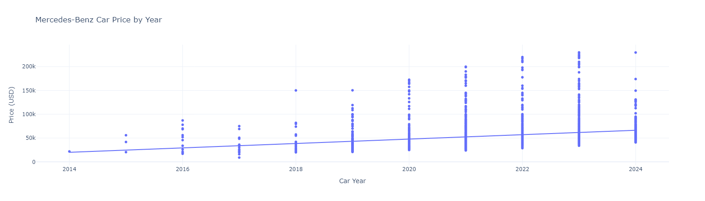
Car price shows a clear upward trend over the years, with newer models (especially from 2020 onwards) exhibiting significantly higher price ranges and outliers.
Older car models (2014–2017) are generally lower priced and show less price variability.
The trendline in the price-by-year scatter plot suggests consistent price appreciation over time, reflecting either newer technology, market value, or inflationary effects.

Slide 7
Topic 2: Exploring the Relationship Between Fertility Rate and Median Age Across Countries
Hypothesis:
Null Hypothesis (H₀): There is no correlation between fertility rate and median age across countries. (ρ = 0)
Alternative Hypothesis (H₁): There is a significant negative correlation between fertility rate and median age across countries. (ρ < 0)
Data Transformation and Analysis
Removed all percentage signs (%) from the data values to convert them into numeric format.
Kept the negative signs for values that represent decreases or negative quantities.
Kept all values as numeric strings or integers/floats for easy further processing.
Using pearson k correlation to test correlation between the data

Slide 8
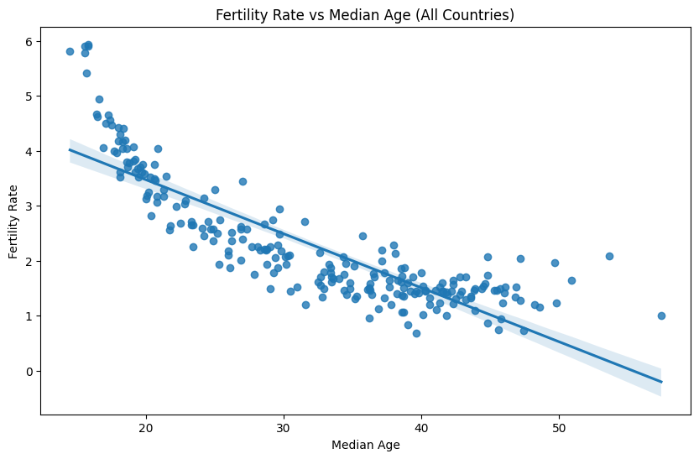
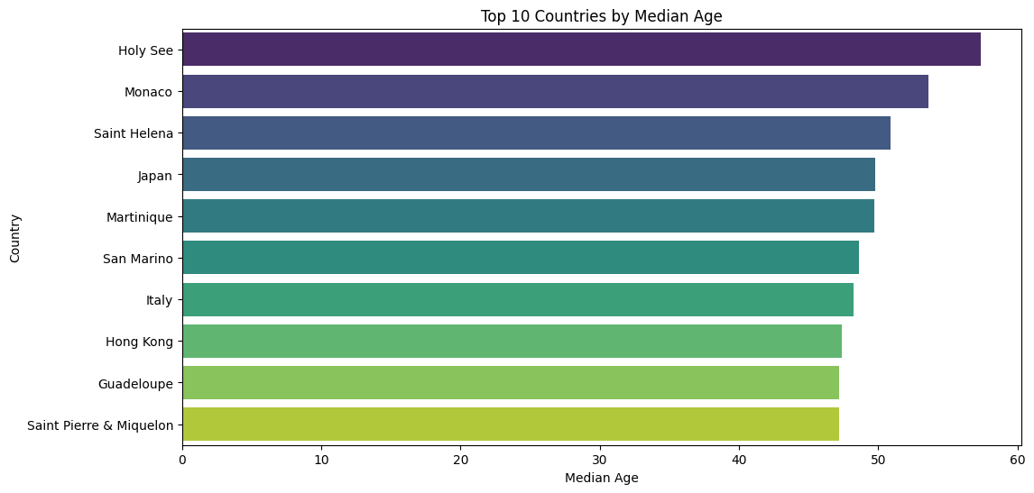
Insights and Visuals
There is a strong negative correlation between median age and fertility rate; as median age increases, fertility rate decreases.
Most countries fall along or near the regression line, indicating a consistent trend globally.
Countries with lower median ages tend to have higher fertility rates (above 3 children per woman).
Countries with higher median ages tend to have lower fertility rates, often below the replacement level of 2.1.

Slide 9
Challenges Encountered
Finding the same data from different sources was difficult due to variations in values, formats, or update frequencies.
Data cleaning takes more time due to tasks like removing units, handling missing values, and standardizing formats.
Raw data contain inconsistencies, typos, and irrelevant entries that were carefully filtered out to maintain analysis accuracy.
Library installation issues occurs when one library depends on another with specific version constraints.
Conflicts between dependencies cause errors during installation requiring troubleshooting or restarting notebook

Slide 10
Conclusion and Next Steps
Analysis of Price Trends for Mercedes-Benz Cars in the USA
Relationship Between Fertility Rate and Median Age Across Countries
The study provides valuable insights into the key determinants of Mercedes-Benz vehicle pricing in the U.S. market. It reveals that mileage and car year are the most influential factors, with newer models commanding higher prices and higher mileage leading to price depreciation. The weak correlation of customer reviews and ratings with price suggests that buyers prioritize vehicle condition and age over subjective feedback. While the current predictive model offers a basic estimation capability, it significantly underperforms on high-end prices, indicating the need for model enhancement.
Next Steps:
Model Improvement: Incorporate additional features such as engine type, trim level, location, and service history to improve prediction accuracy.
Data Enrichment: Expand the dataset to include more vehicle attributes and market segments for broader applicability.
Model Optimization: Explore advanced regression techniques or ensemble learning methods (e.g., XGBoost, LightGBM) to better capture non-linear price patterns.
Deployment: Develop a user-friendly pricing tool or dashboard for real-time valuation assistance for buyers and sellers.
The analysis demonstrates a strong inverse relationship between a country's median age and its fertility rate, underscoring a significant global demographic trend. As median age increases, fertility rates tend to decline, a pattern observed consistently across most countries in the dataset. Countries with some of the highest median ages, including Japan, Italy, Monaco, and others, exhibit fertility rates well below the replacement threshold of 2.1 children per woman.
Next Steps:
Incorporate additional variables such as GDP per capita, education levels, or healthcare access to enrich analysis.
Use time-series data to study how median age and fertility rates have changed over the years.
Develop predictive models to estimate future fertility trends based on projected median age shifts.

